Slide 1
Quality Prescribing for Chronic Pain – An Introduction
Delivered by / Contact Details
Date
Notes:
Why are we having an Pain Prescribing Initiative?

Slide 2

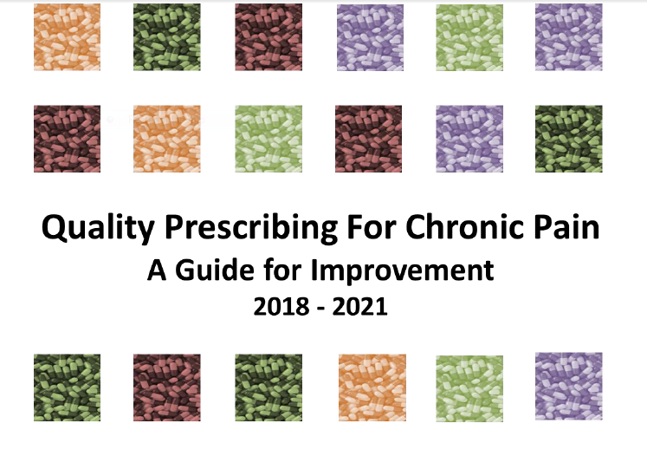
Notes:
Set the scene with why they are getting the presentation
The Board is looking to improve the quality of its prescribing and is implementing the Scottish “Quality Prescribing For Chronic Pain- A Guide for Improvement” which was launched in early 2018
The guide has been written by Scottish Government and NHS Scotland to promote quality improvement in the prescribing of analgesic medicines and, equally importantly, to integrate non-pharmaceutical therapeutic approaches to management of chronic pain. The document is aimed at Primary Care clinicians, General Practice Clusters and NHS teams with responsibility for promoting best practice in medicines prescribing.
The document has a safe, effective use of medicine focus with key themes being:
Non pharmaceutical approach
Holistic approach to care
Mindful initiation
Fully informed involved patients discussing risk, expectation , trials of cessation to assess for ongoing need
Review, review, review
Part of a set of 3 quality prescribing guides- , respiratory, diabetes- which are a refresh and pain which is new. All are underpinned by the Polypharmacy strategy
The guide was produced by a multidisciplinary team including third sector from all across Scotland

Slide 3
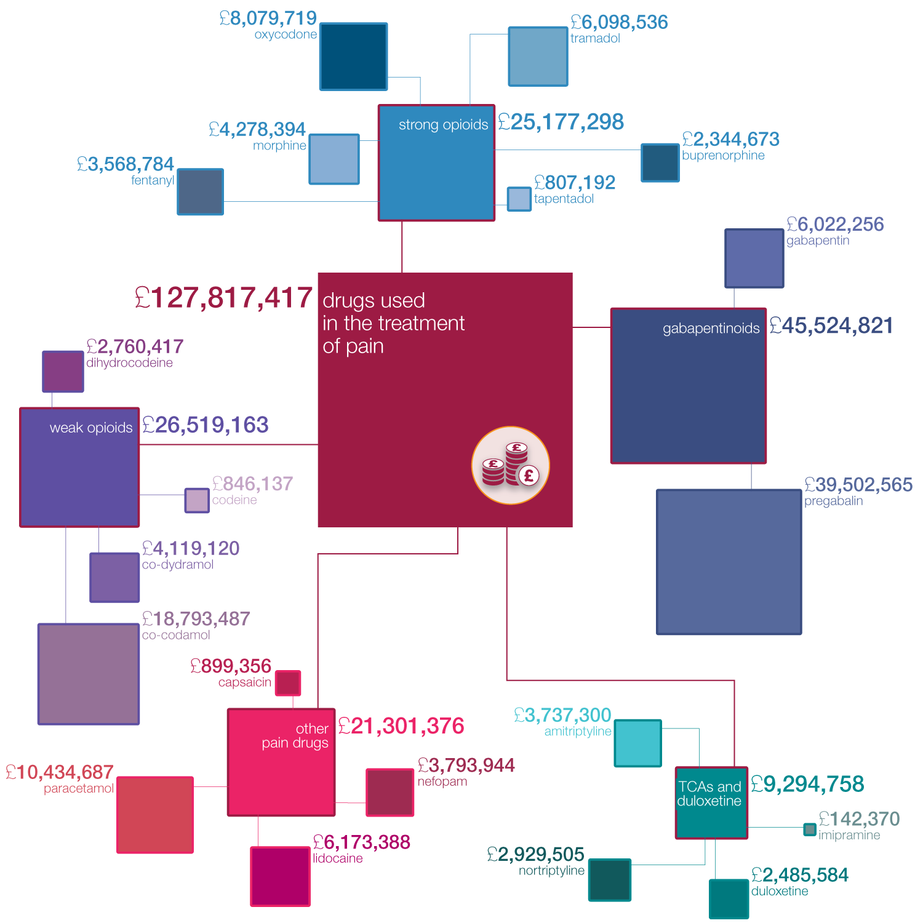
ISD 2017 – January to December 2016 Data
Notes:
Explain the chart – the bigger the box , the higher the spend
Primary care medicine spend is currently just over £1bn – so this is a significant part of our care spend
Presenters could ask their group how much they think is spent on pain medication in Scotland, to generate discussion

Slide 4
The maps demonstrate change in cost per treated patient since 2012.
Notes:
Explain that this graph shows the difference in cost per treated patient for 2012 versus 2016
Note the hotter the colour the higher the spend
Explain what cost per treated patient is – cost of analgesic medicines prescribed per patient treated with analgesics
Can’t say why that is - We can’t say that its bad prescribing, just that its the highest spend.

Slide 5
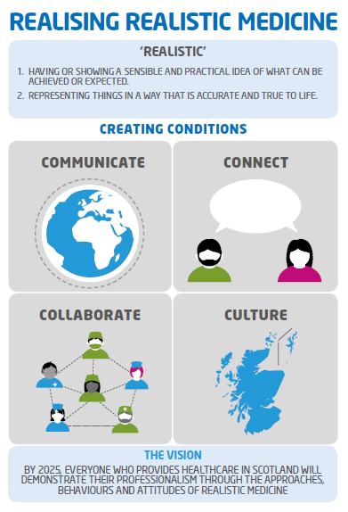
Realistic Medicine: Goals
Reducing the burden of overtreatment
Reducing unwarranted variation
Ensuring value for money
Combining the expertise of patients and professionals
Improving the patient-doctor relationship
Identifying and managing clinical risk
Notes:
Note the alignment between this document and the goals of realistic medicine.
Also note the levels – Pain Prescribing – Polypharmacy – Realistic Medicine. Importance of all working together, we think this delivers that

Slide 6

What is the purpose of the guide?
Notes:
Provide a framework to promote quality improvement in prescribing for adults with chronic pain across primary care in Scotland, particularly focussing on delivery of safe, person-centred care.
In addition, it promotes self-management and non-pharmaceutical management of chronic pain and disseminates prescribing quality indicators that can be used to monitor and review analgesic prescribing and variation in practice across Scotland.
Provides a toolkit and framework for GPs

Slide 7

Clinicians should….
Pursue non-pharmaceutical approaches
Follow a clinically appropriate approach to initiation of medication
Develop a clear management plan
Review effectiveness, tolerability and compliance
Notes:
Pursue non-pharmaceutical approaches wherever possible, either alone or in conjunction with medicines. Self-management should be actively encouraged and supported.
Follow a clinically appropriate approach to initiation of medication, discussing risks and benefits and incorporating agreed criteria for stopping/continuing medication. Initiation should be on a short term trial basis at first, to assess effectiveness
Develop a clear management plan collaboratively with patients, This will include:
Including regular review dates. Patients should have early and frequent review dates, particularly those prescribed opioids or gabapentinoids. A trial of cessation should be included in the plan, to assess for ongoing need regardless of efficacy
Expectations should be addressed and clarified. Prescribers should work with patients to develop their understanding of chronic pain, how it differs from acute pain and the impact this may have on goals of therapy. Difficult and honest conversations may be required to establish an understanding with the patient that it is highly unlikely that the therapeutic management plan will result in full resolution of their pain symptoms (>30%), but it may assist them with coping.
The patient should be advised of the risks associated with their medicine, such as side effects.
Prescribers and patients should be aware of the lack of evidence for long term use of analgesics
The plan should focus on what matters to the patient.
Review effectiveness, tolerability and compliance on a regular basis. Medicine burden should be reduced where possible, in line with Polypharmacy guidance.

Slide 8
What does a good effect of an analgesic look like?
Notes:
Pause and get the audience to think about this and answer
A 30% reduction in pain and an improvement in function would be a good outcome
Analgesic studies historically have not been well conducted.
A recent meta-analysis of the pharmacotherapy for neuropathic pain in adults showed that outcomes were relatively modest. Trials were included with treatments lasting longer than 3 weeks’ duration and achieved 50% pain relief with the following Numbers Needed to Treat (NNT) and Numbers Needed to Harm (NNH). Finnerup NB et al 2015. Pharmacotherapy for neuropathic pain in adults a systematic review and meta-analysis

Slide 9
What are the risks associated with analgesic prescribing?
Notes:
Pause and get the audience to think about this and answer
There is increasing evidence that many analgesics, including opioids, gabapentin and pregabalin, have the potential for harm and abuse.
Cases of dependency have been described and there are reports of an increasing street value and risk of drug misuse.
Evidence also highlights that over recent years there has been a significant increase in the number of drug related deaths where both gabapentin and pregabalin have been involved, although patients have normally been on other drugs and pregabalin/gabapentin are not necessarily the cause.
Public Health England. Advice for prescribers on the risk of the misuse of pregabalin and gabapentin
Willis S. Drugs of Abuse. 2nd ed. London: Pharmaceutical Press; 2005
www.rcoa.ac.uk/faculty-of-pain-medicine/opioids-aware/clinical-use-of-opioids/crime-survey-findings
https://www.nrscotland.gov.uk/files//statistics/drug-related-deaths/drd2016/16-drug-rel-deaths.pdf - Table Y, Page 71

Slide 10
What is the evidence for long term opioid effectiveness and what dose is safe?
Notes:
Pause and get the audience to think about this and answer
Not only is there a lack of evidence for efficacy of opioids in the long term treatment of chronic pain there is also considerable risk, such as increased risk of overdose, fractures, abuse or dependence; this should be explicitly discussed with patients. A recent Cochrane reviews found an increased risk of adverse events with opioids vs placebo and vs non-opioid active comparator. There was also an increased risk of serious adverse events vs placebo. The authors noted that “based on the adverse events identified, clinically relevant benefit would need to be clearly demonstrated before long-term use could be considered in people with chronic non-cancer pain in clinical practice”.
The US Department of Health suggests reconsidering “the individual benefits and risks when increasing dosage to ≥50 Morphine Equivalent Dose (MED)/day, and should avoid increasing dosage to ≥90 MED/day or carefully justify a decision to titrate dosage to ≥90 MED/day”. US Dept of Health – Centres for Disease Control and Prevention – March 2016 – Checklist for Prescribing Opioids for Chronic Pain
Chou, R et al. The Effectiveness and Risks of Long Term Opioid Therapy for Chronic Pain: A Systematic Review for a National Institutes of Health Pathways to Prevention Workshop
Els, C et al. Adverse events associated with medium- and long-term use of opioids for chronic non-cancer pain: an overview of Cochrane Reviews. Cochrane Database of Systematic Reviews 2017, Issue 10. Art. No.: CD012509. DOI: 10.1002/14651858.CD012509.pub2.

Slide 11
What is the evidence for effectiveness of lidocaine patches?
Notes:
Pause and get the audience to think about this and answer
There is no evidence from good quality randomised controlled studies to support the use of topical lidocaine to treat neuropathic pain, although some individual studies (low quality) indicate that it is effective for pain relief. Lidocaine 5% medicated plaster is licensed for use in Postherpetic Neuralgia (PHN). It may be used in patients who have very localised neuropathic pain and who are intolerant of first line therapies, or where these therapies have been ineffective. Lidocaine patches should be worn for 12 hours on and 12 hours off, reviewed after 2 weeks and stopped if ineffective. If the patient has responded to treatment and the plaster has alleviated pain completely then a plaster-free period should be trialled after seven days of plaster use (remove for 24 hours and assess need to restart). Treatment should be reassessed frequently to decide whether the amount of plasters needed to cover the painful area can be reduced, or if the plaster-free period can be extended.
Derry S, Wiffen PJ, Moore RA, Quinlan J. Topical lidocaine for neuropathic pain in adults. Cochrane Database of Systematic Reviews 2014, Issue 7

Slide 12
What local guidelines are available for chronic pain?
Notes:
Pause and get the audience to think about this and answer

Slide 13
Local prescribing guideline
Notes:
Boards should insert local prescribing guidance at this stage, and discuss as appropriate

Slide 14
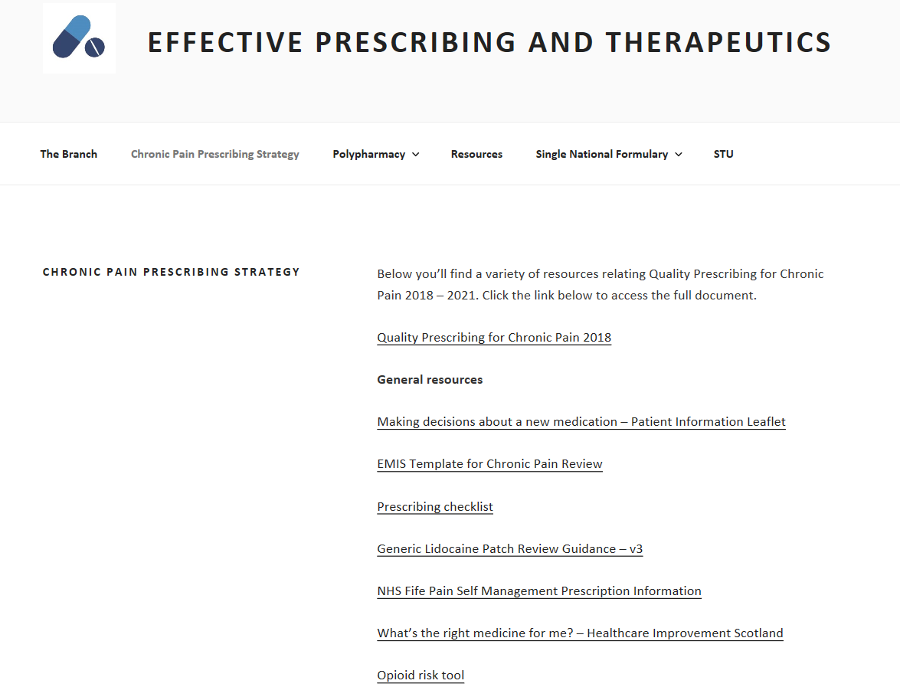
Board section
Notes:
The website contains case studies with examples of whole system approaches / interface initiatives
Variety of other resources, including review guides for lidocaine and SLANNS tool
Scottish Therapeutics Utility (STU) is software which runs searches in GP practices to identify patients with certain criteria e.g patients on >120mg of morphine equivalent/day. General intro to STU.

Slide 15
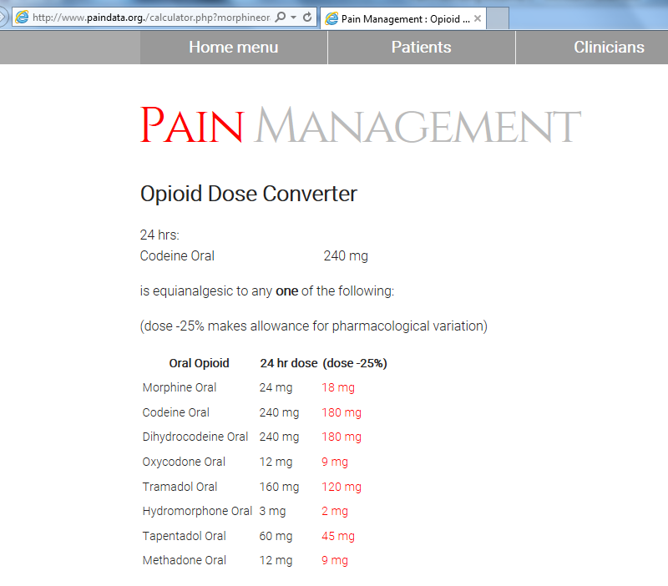
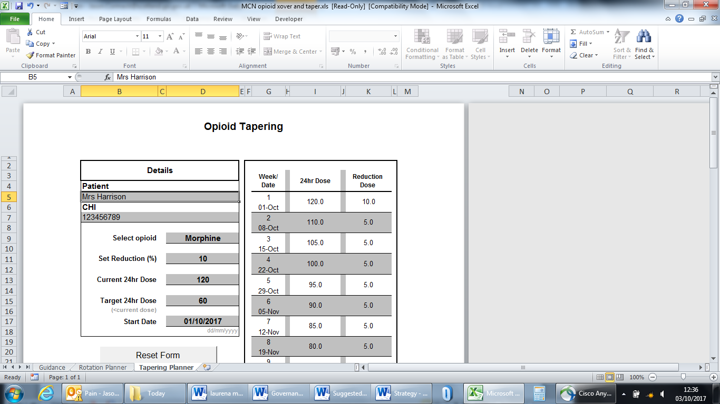
Opioid Equivalence and tapering tool
Notes:
Highlight the availability and functionality of the opioid equivalence calculator and the taper guide ( not posted yet at 9th May 2018- need to check). Variety of resources available on the website, Boards should customise this slide with what they wish to highlight.
http://www.paindata.org./calculator.php?morphineoral=&codeineo=240&dhco=&oxycodoneo=&tramadolo=&hydromorphoneo=&tapentadolo=&methadoneo=&fentanylsc=&diamorphsc=&alfentanilsc=&hydromorphonesc=&oxycodonesc=&morphineiv=&fentanyliv=&fentanylpatch=&buprenorphinepatch=&morphineepid=&morphinespinal=&dothis=convert

Slide 16

What does good look like?
Notes:
Variation- difficult to specify what good looks like and its to do with appropriateness of prescribing.....
Generally for analgesics we are aiming to reduce.......

Slide 17
Board section
Notes:
Boards should review the strategy and copy in any board, hscp or cluster level data they wish to discuss. The chart above and text below is an example.
There is no evidence from good quality randomised controlled studies to support the use of topical lidocaine to treat neuropathic pain, although some individual studies (low quality) indicate that may be effective for relief of pain. Lidocaine prescribing should be reviewed regularly to ensure efficacy

Slide 18
Board section
Notes:
These gaps are for Boards to select charts from the strategy and discussion points looking at local priorities

Slide 19
Board Section
Notes:
These gaps are for Boards to select charts from the strategy and discussion points looking at local priorities

Slide 20
Board Section
Notes:
These gaps are for Boards to select charts from the strategy and discussion points looking at local priorities

Slide 21
What does it mean for OUR BOARD/CLUSTER
Notes:
This should be a discussion of the key points from the strategy FOR THIS BOARD and/or cluster/practice etc

Slide 22

Actions.....
Notes:
Provide the take home messages and actions for this audience

Slide 23
Questions ????

