Slide 1
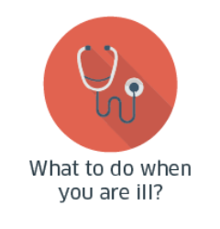

Medication sick day guidance
What is medication sick day guidance, and why do we need it?
Dr Iain Wilson - Effective Prescribing and Therapeutics division Scottish Government

Slide 2
This session will cover:
What is medication sick day guidance, and why do we need it?
What is a dehydrating illness?
What medicines should I withhold and when should I restart medication?
How can we do as care home staff help?
Messages for residents and their families

Slide 3
What is sick day guidance?
The sick day guidance is a useful resource for patients, carers, and healthcare professionals.
It raises awareness of potential harms from medicines during a dehydrating illness.
The guidance is simple and easy to access in paper or digital form so you can have it to hand when you need it.

Slide 4
Why is it needed, and when do I use it?
Taking certain medicines when you are dehydrated can lead to a more serious illness.
If someone has an illness that could leave them dehydrated, they should temporarily stop taking these medicines until they feel better.

Slide 5
What is a dehydrating illness?
Dehydrating illnesses are:
  Vomiting (unless only minor)
  Diarrhoea (unless only minor)
  Fever (sweats and shaking, unless only minor)
If someone is sick once or has diarrhoea once, then they aren’t likely to become dehydrated, but if they are sick or have diarrhoea twice or more, you should use the sick day guidance.

Slide 6
Hospital admissions and adverse drug reactions

Slide 7
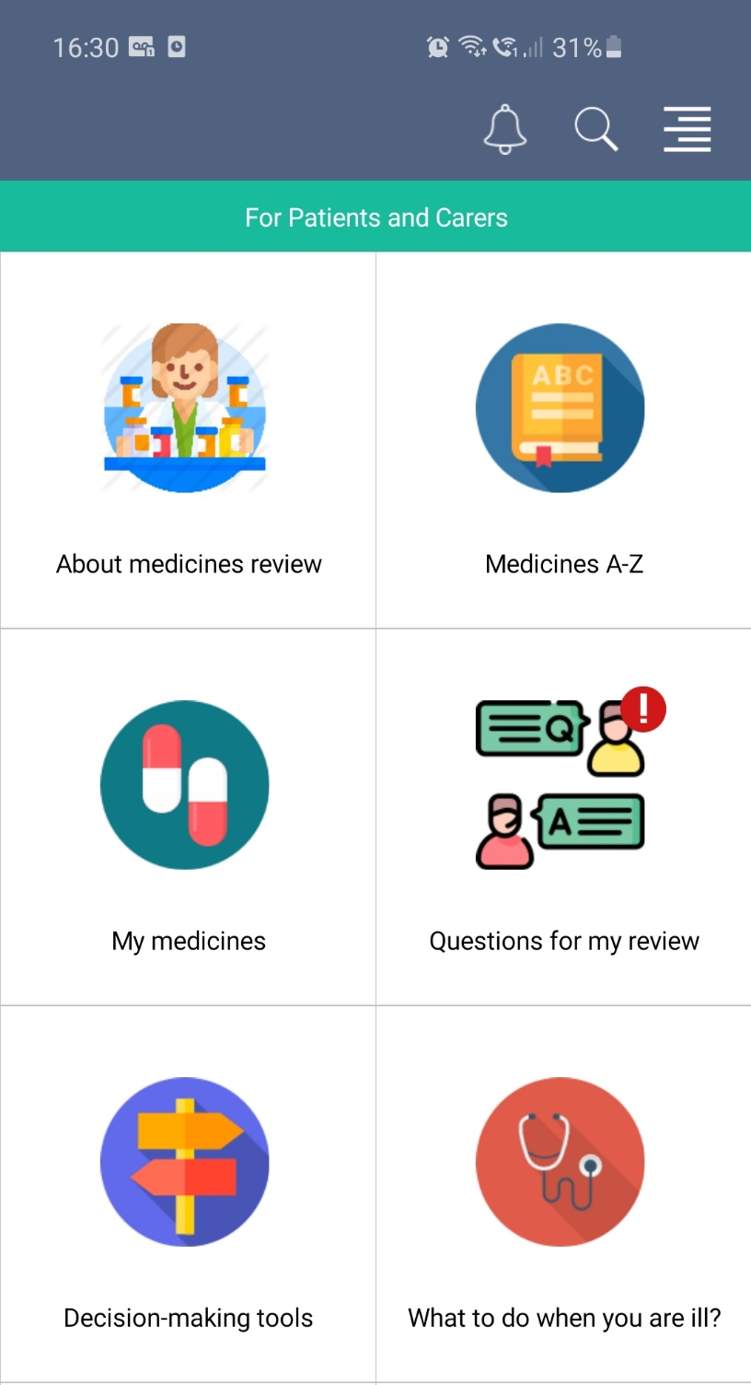
The guidance is available as sick day cards or on the free Polypharmacy: Manage Medicines app
Notes:
You can download the free app for yourself, or help the residents or their families to do this on their own devices

Slide 8
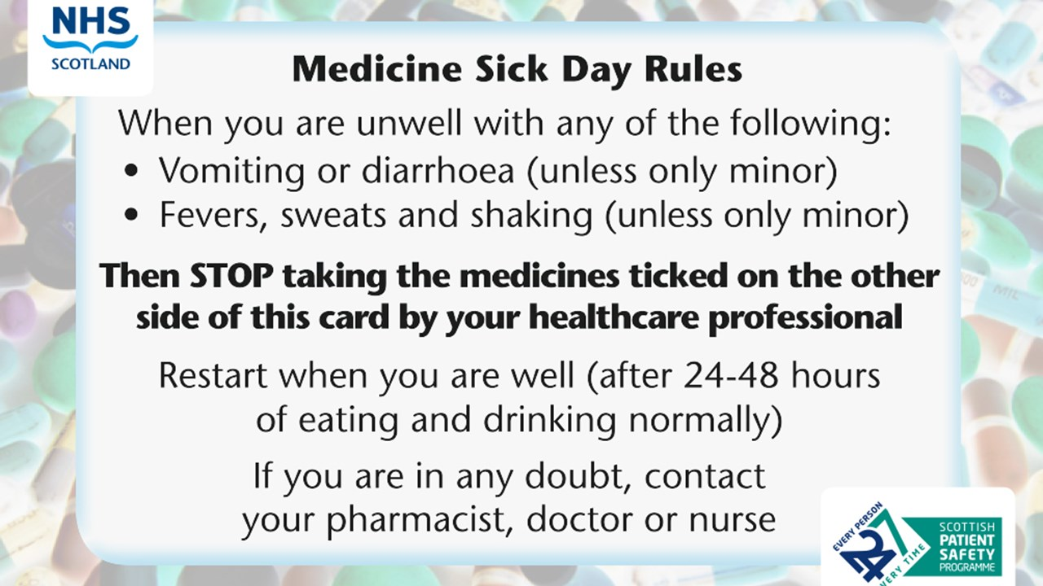
The sick day guidance

Slide 9
What medicines are covered?
Type of medicine |  | Why | Examples
Medicine for diabetes | SGLT2 | Dehydration can make it more likely you will develop a serious side effect called lactic acidosis. | Names ending in “flozin” e.g. empagliflozin, canagliflozin, dapagliflozin
Medicine for high blood pressure & heart conditions | ACE inhibitors | If dehydrated, these medicines can stop your kidneys working properly. | Names ending in ‘pril’ e.g. lisinopril, perindopril, ramipril
‘Water pills’ for excess fluid & high blood pressure | Diuretics | Can make dehydration more likely. | furosemide, bendroflumethiazide, indapamide, spironolactone
Medicine for diabetes | Metformin | Dehydration can make it more likely you will develop a serious side effect called lactic acidosis.
Medicine for high blood pressure & heart conditions | ARBs | If dehydrated, these medicines can stop your kidneys working properly. | Names ending in ‘sartan’ e.g.losartan, candesartan, valsartan
Anti-inflammatory pain killers | NSAIDs | If dehydrated, these medicines can stop your kidneys working properly. | ibuprofen, naproxen, diclofenac

Slide 10
Restarting medication

Slide 11
Restarting medication
Stopping taking the medication should only be temporary, while the person is at risk of dehydration.
Remember: When they are better, it is important that they start taking the medicines again.
When restarting medicines - this would normally be after 24 to 48 hours of eating and drinking normally, just take them as normal. Do not give extra for the doses they have missed.

Slide 12
How we as care home staff can help:
Read and get to know the guidance
Download the app and cards so you have the advice to hand
Tell residents and their families about the guidance and the app, and that you will help them if they are sick and need to stop taking any of their medicines
Put up the poster and talk about the guidance so it is familiar when someone needs it

Slide 13
Messages for residents and families:
We will be using the sick day guidance on the cards and app
Some medicines shouldn’t be taken when you have an illness that makes you dehydrated.
We will help if you are feeling sick to know which medicines to stop taking, and remind you to start taking them again when you are better
Display the poster so everyone knows about the guidance
Invite residents and families to download the app

Slide 14
Thank you
EPandT@gov.scot

